Slide 1


Real-Time Data Pipeline for Website Traffic Analytics
DSCI 6007- Distributed and Scalable Data Engineering
Midterm Project
Team 04 - Section 01
Hrishabh Mahaju
Sahil Ghelani
Yaminipoojitha Rayadurgam
05 March, 2025

Slide 2



Team 4 Section 01
Introduction
Purpose: Real-time website traffic analysis
Why AWS? Scalability, reliability, cost-efficiency
Relevance: Data-driven decision-making in modern systems

Slide 3



Team 4 Section 01
Project Objective
Design a real-time data pipeline
Process high-velocity website traffic logs
Deliver low-latency insights using AWS

Slide 4




Team 4 Section 01
AWS Services - Ingestion & Processing
Amazon Kinesis: Real-time data streaming
High throughput, low latency
AWS Lambda: Serverless processing
Event-driven, auto-scaling

Slide 5


Team 4 Section 01
Amazon S3: Durable data lake
Scalable, versioned storage
Amazon Redshift: Analytical data warehouse
MPP, SQL-based querying
Amazon QuickSight: Visualization
Interactive dashboards, ML insights
AWS Services - Storage & Analytics

Slide 6

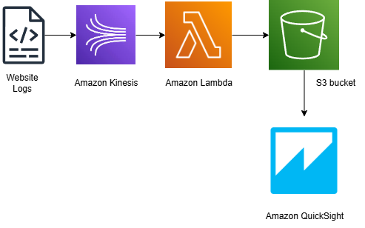
Team 4 Section 01
Flow:
Website Logs → Kinesis → Lambda → S3 → QuickSight
Key Features: Real-time, fault-tolerant, scalable
Project Data Flow

Slide 7

Team 4 Section 01
Cost Estimation
Total: $5 - $15/month
Breakdown:
Kinesis: ~$11 (1 shard)
Lambda: ~$0.20 (Free Tier)
S3: ~$0.23 (10 GB)
Redshift: ~$2 (limited usage)
QuickSight: ~$1 (Free Tier)

Slide 8


Team 4 Section 01
Conclusion & Key Takeaways
Proposal: Scalable, secure pipeline
Cost: $5 - $15/month
Next Steps: Implementation

Slide 9

Team 4 Section 01
Thank You

